Slide 1

Active Directory: The good, The bad, and the lolWUT?
Defcon 31 Workshop

Slide 2
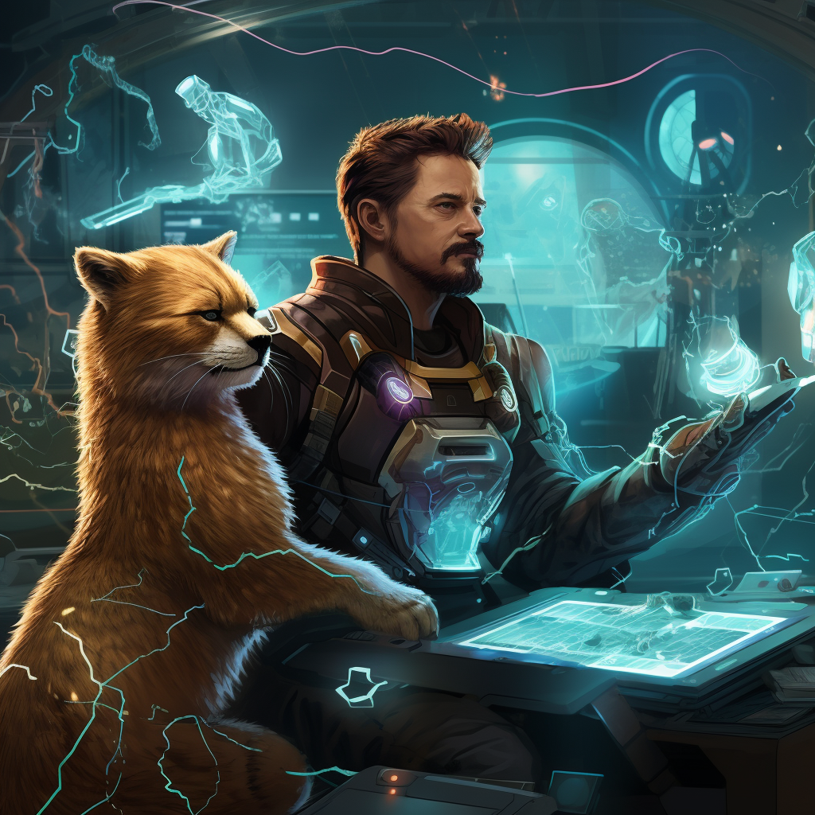
Aaron Rosenmund @arosenmund

Slide 3
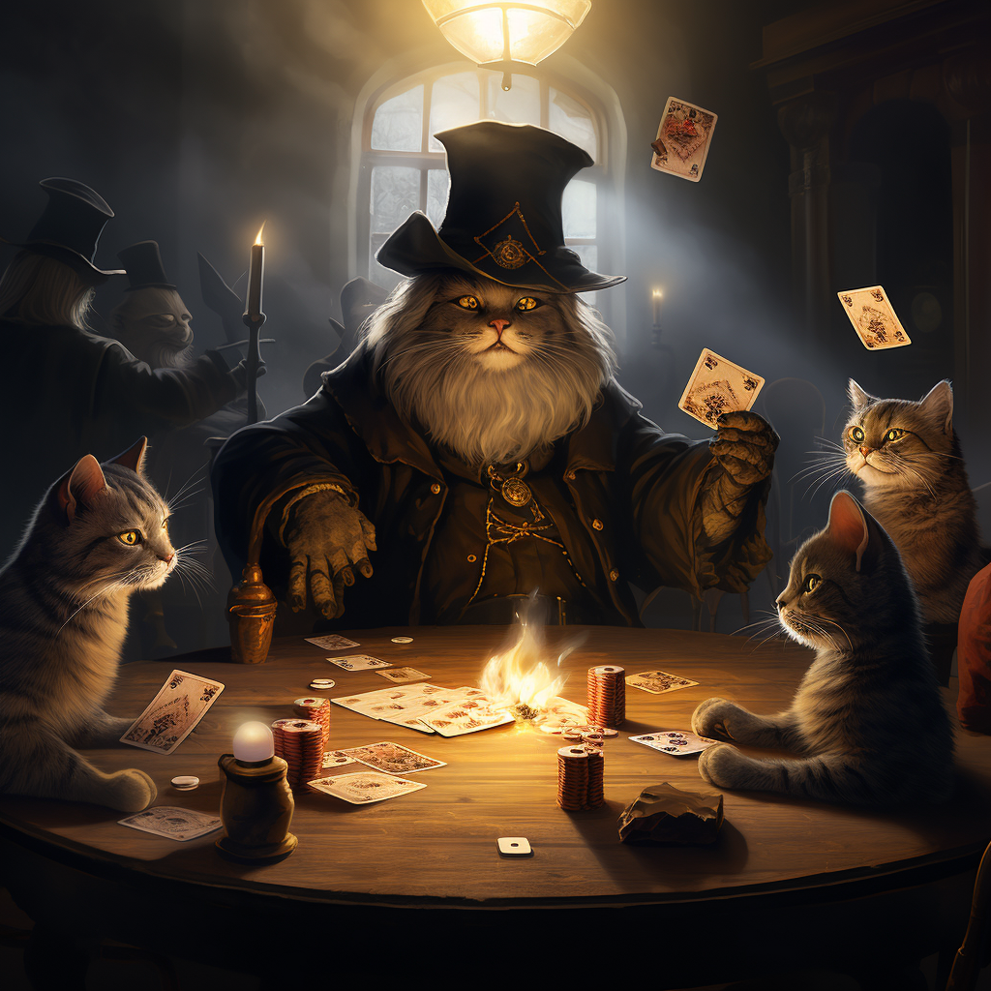
Brandon DeVault @DeVaultsecurity
“Papa was a gambling man, always on the move” is the quote on Brandons grave stone. A funeral held without a body, but the old Brandon will never return. Making a deal to gain access to magic, it came with a cost, as we was transformed into a half man half cat. Embracing his love of cards and close up magic, he makes a quick buck off hustling tomcats at the tables by day, and works cyber magic by night to stay in touch with his humanity.

Slide 4
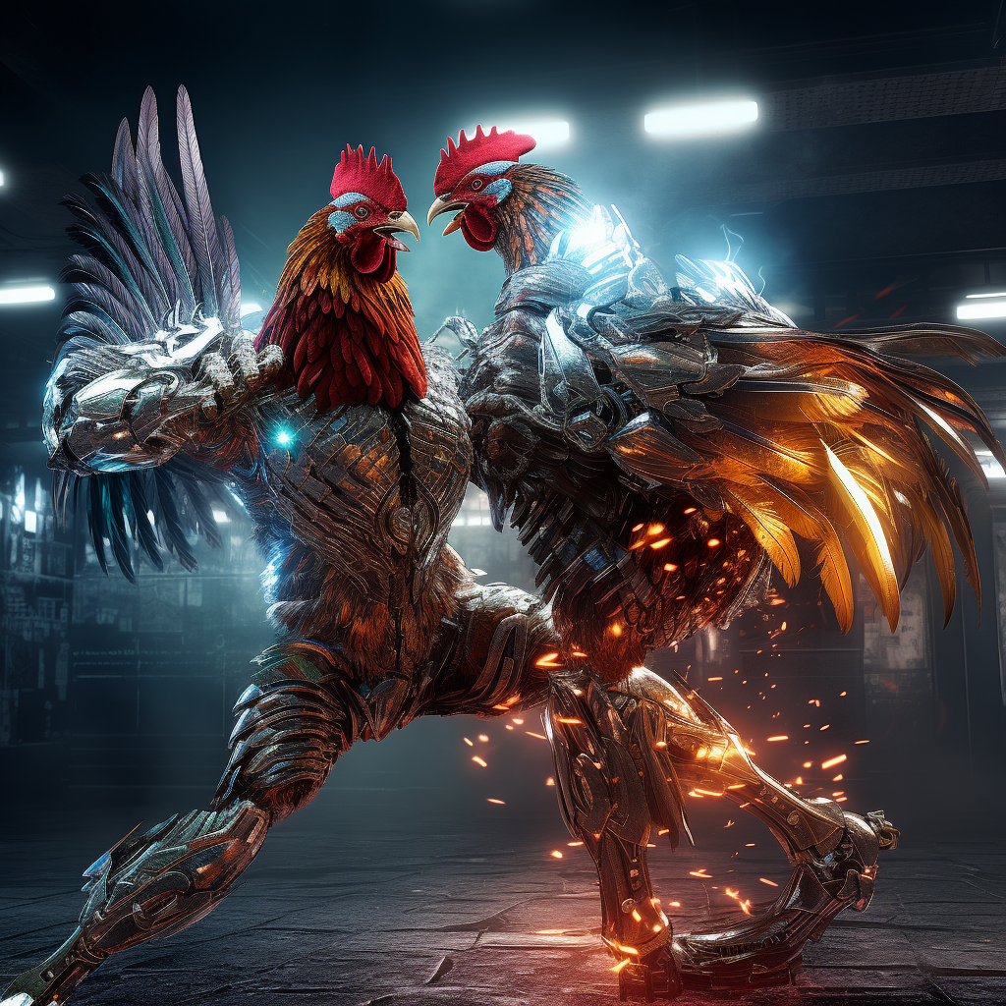

Ryan Chapman @rj_chap
While playing in an abandoned chicken processing factory as a child in Chile, Ryan very stereotypically fell into a vat of chemicals that forever changed him. Turning the ultimate set of lemons into lemonade, if lemonade was a cybernetically enhanced humanoid chicken, the doctors were able to enable him to have somewhat normal function by grafting his body with machines. Now known as the undefeated Mac Diablo in central America. He has carved out a stable life fighting in high stakes cockfighting games by day, and leveraging his enhanced connection to machines to hunt down cyber criminals by night.

Slide 5
Active Directory
Post Exploitation Tradecraft

Slide 6
Attack Chain
Adding an attack chain shorty.

Slide 7
Credential Grabbing
Common Threat Actor Techniques
Mimikatz
Detections for Common Techniques
Powershell & Sysmon
Advanced Techniques and Defense Evasion
Custom tooling, Windows Defender Evasion

Slide 8
Enumeration
Common Threat Actor Techniques
Mimikatz
Detections for Common Techniques
Powershell & Sysmon
Advanced Techniques and Defense Evasion
Custom tooling, Windows Defender Evasion

Slide 9
Kerberoasting
Common Threat Actor Techniques
Mimikatz
Detections for Common Techniques
Powershell & Sysmon
Advanced Techniques and Defense Evasion
Custom tooling, Windows Defender Evasion

Slide 10

The Lab Environment Account Required: www.pluralsight.com/free (no cc required)

Slide 11
Active Directory Sandbox

Slide 12
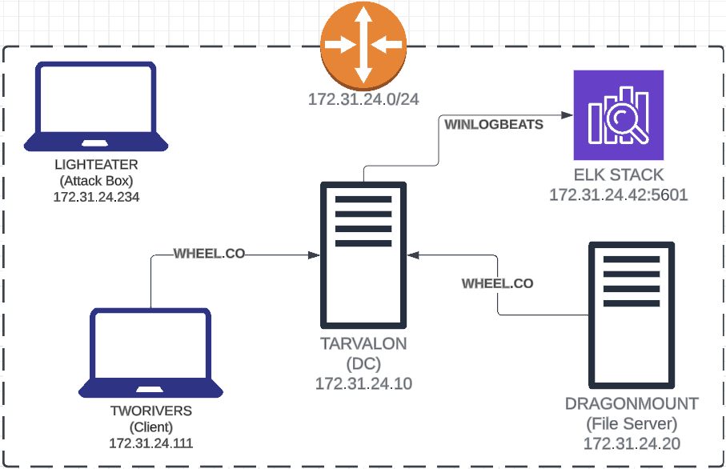

Slide 13
